Slide 1
SSW-555: Agile Methods for Software Development
Introduction
Extreme Programming/XP
Prof. Jim Rowland
Software Engineering
School of Systems and Enterprises

Slide 2
Just for fun…

Slide 3

Today’s topics
Software development method comparison
Motivations for agile methods
Rational Unified Process (RUP)
Boehm's risk exposure comparison
Overview of Extreme Programming (XP)

Slide 4
Acknowledgements
Lecture material comes from a variety of sources, including:
https://www.tutorialspoint.com/sdlc/sdlc_quick_guide.htm
Software Engineering, 10th Edition, Ian Sommerville
Scott W. Ambler www.ambysoft.com/surveys/
"Get ready for agile methods, with care" by Barry Boehm, IEEE Computer, January 2002.
http://agilemanifesto.org/
http://www.extremeprogramming.org/

Slide 5
How much planning?
What’s the right level of planning for software projects?
It depends on the task!
How should we decide?
What’s the domain?
How complete are the requirements?
How stable are the requirements?
What’s the cost of doing the wrong thing?
What’s the cost of doing the right thing too slowly?
What are the risks?
What are the rewards?

Slide 6
Software Development Life Cycle (SDLC)
What problems are we trying to solve in any SDLC?
Software specification
What functionality must we support?
Software development
How do we create the software that delivers the functionality?
Software validation
How do we verify that the software does what it’s supposed to do?
Software evolution
How does the software evolve to meet customer needs?
Source: Software Engineering, 10th Edition, Ian Sommerville

Slide 7
SDLC Methods
Chaos/Big Bang
Agile Methods
Flelxible
Iterative
Spiral
Rigid
Waterfall/V
Sequential
Iterative

Slide 8
Waterfall Model
Waterfall Model
Plan everything in sufficient detail so we can get it right the first time
<sarcasm> not likely </sarcasm>
Popular approach with traditional engineering problems, e.g. building bridges
Very formal process
Extensive documentation
Serial execution
Complete each stage before starting next
Very difficult to go back to earlier stages
Strict handoffs between stages
“Signed off in blood”
https://upload.wikimedia.org/wikipedia/commons/thumb/e/e2/Waterfall_model.svg/1280px-Waterfall_model.svg.png

Slide 9
Waterfall Model
When is Waterfall appropriate?
When we must get it right the first time!
Cost of failure is very high
Complete requirements
Examples:
Interacting with embedded hardware systems
Very difficult/expensive to change the hardware components
Critical systems with extreme safety or security requirements
e.g. airplanes, self-driving cars, …
Very large, multi-organizational software projects

Slide 10
V (Verification/Validation) SDLC Model
Add verification/testing to each step of the Waterfall Model
Must complete rigorous testing before proceeding to next step
https://sites.google.com/site/advancedsofteng/software-acquisition/software-development-lifecycle-approaches

Slide 11
Boehm’s Spiral Model
Recognizes limitations of Waterfall
Hard to get it right the first time… Customers don’t know what they want
Adds focus on risk assessment
Encourages incremental development and iterations
Learn from previous iterations
Each spiral includes:
Objective setting
Risk assessment and reduction
Development and validation
Planning
http://iansommerville.com/software-engineering-book/web/spiral-model/

Slide 12
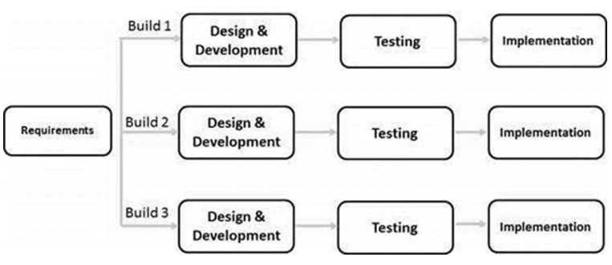
Iterative models SDLC
Recognizes limitations of Waterfall
Hard to get it right the first time… Customers don’t know what they want
Identify requirements up front
Build subsets of requirements
Sequentially or in parallel with multiple groups of developers
Requirements are mostly stable but may change
Works well for large projects that can be developed in parallel efforts
Delivers early functionality to customers for review
https://www.tutorialspoint.com/sdlc/sdlc_quick_guide.htm

Slide 13
Agile Methods SDLC
Frequent iterations and deliverables
Close collaboration between customers and developers
Customer is a critical partner in the process rather than an observer
Supports changing requirements
Frequent reflection and continuous improvement
What are we doing well?
What can we improve?
Learn and improve from experience
https://www.pinterest.com/pin/553168766708998354/

Slide 14
Big Bang/Chaos SDLC
Little to no planning
Figure it out as you go
Typically used for very small projects
Not highly recommended…

Slide 15

Comparing Software Development Paradigms: 2013
Notes:
The levels of success were defined as follows:
Successful. A project is considered successful if a solution has been delivered and it met its success criteria within a range acceptable to your organization.
Challenged. A project is considered challenged if a solution was delivered but the team did not fully meet all of the project's success criteria within acceptable ranges (e.g. the quality was fine, the project was pretty much on time, but ROI was too low).
Failed. The project team did not deliver a solution.
The paradigms were defined as follows:
Ad-hoc. On an ad-hoc software development project the team does not follow a defined process.
Iterative. On an iterative software development project the team follows a process which is organized into periods that are often referred to as iterations or time boxes. On any given day of the project team members may be gathering requirements, doing design, writing code, testing, and so on. An example of an iterative process is RUP. NOTE: We will ask about Agile projects, which are defined as iterative projects that are performed in a highly collaborative and lightweight manner, later.
Agile. On an agile software development project the team follows an iterative process which is also lightweight, highly collaborative, self-organizing, and quality focused. An example of an agile process is Scrum, XP, and Disciplined Agile Delivery (DAD).
Traditional. On a traditional software development project the team follows a staged process where the requirements are first identified, then the architecture/design is defined, then the coding occurs, then testing, then deployment. Traditional processes are often referred to as "waterfall" or simply "serial" processes.
Lean. Lean is a label applied to a customer value-focused mindset/philosophy. A lean process continuously strives to optimize value to the end customer, while minimizing waste which may be measured in terms of time, quality, and cost. Ultimately the Lean journey is the development of a learning organization. Examples of Lean methods/processes include Kanban and Scrumban.
Success rates were calculated using the following strategy:
A weighted average for each of level of success was calculated. A selection of 91-100% was considered to be 95%, 81-90% as 85% and so on. A selection of 0 was considered as 0. Answers of Don’t Know were now counted.
A normalized value was calculated. The weighted averages didn’t always add up to 100%. For example, the weighted averages may have been 60% 30% and 20% for a total of 110%. To normalize the values we divided by the total, to report 60/110, 30/110, and 20/110.

Slide 16
Comparing Delivery Paradigms
Notes:
The levels of success were defined as follows:
Successful. A project is considered successful if a solution has been delivered and it met its success criteria within a range acceptable to your organization.
Challenged. A project is considered challenged if a solution was delivered but the team did not fully meet all of the project's success criteria within acceptable ranges (e.g. the quality was fine, the project was pretty much on time, but ROI was too low).
Failed. The project team did not deliver a solution.
The paradigms were defined as follows:
Ad-hoc. On an ad-hoc software development project the team does not follow a defined process.
Iterative. On an iterative software development project the team follows a process which is organized into periods that are often referred to as iterations or time boxes. On any given day of the project team members may be gathering requirements, doing design, writing code, testing, and so on. An example of an iterative process is RUP. NOTE: We will ask about Agile projects, which are defined as iterative projects that are performed in a highly collaborative and lightweight manner, later.
Agile. On an agile software development project the team follows an iterative process which is also lightweight, highly collaborative, self-organizing, and quality focused. An example of an agile process is Scrum, XP, and Disciplined Agile Delivery (DAD).
Traditional. On a traditional software development project the team follows a staged process where the requirements are first identified, then the architecture/design is defined, then the coding occurs, then testing, then deployment. Traditional processes are often referred to as "waterfall" or simply "serial" processes.
Lean. Lean is a label applied to a customer value-focused mindset/philosophy. A lean process continuously strives to optimize value to the end customer, while minimizing waste which may be measured in terms of time, quality, and cost. Ultimately the Lean journey is the development of a learning organization. Examples of Lean methods/processes include Kanban and Scrumban.
Success rates were calculated using the following strategy:
A weighted average for each of level of success was calculated. A selection of 91-100% was considered to be 95%, 81-90% as 85% and so on. A selection of 0 was considered as 0. Answers of Don’t Know were now counted.
A normalized value was calculated. The weighted averages didn’t always add up to 100%. For example, the weighted averages may have been 60% 30% and 20% for a total of 110%. To normalize the values we divided by the total, to report 60/110, 30/110, and 20/110.

Slide 17
Software development in the 1990s
Large projects (> 40 people, > 1 year)
Used plan-based methods, such as RUP (Rational Unified Process)
More incremental than waterfall, but heavy process
Focus on quality, discipline, process improvement
Medium-sized projects (7-40 people, 3-12 months)
Some used plan-based methods, some used ad hoc methods
Struggled to reduce process overhead while maintaining quality
Small projects (< 7 people, < 3 months)
Many used ad hoc methods (or no methods)
Struggled to achieve greater speed

Slide 18
Software development before Agile
1960s:
Original software crisis leads to "software engineering”
Apply techniques from other engineering disciplines to software
1970s:
Adoption of traditional engineering methods, such as the waterfall model
1980s:
Many attacks on complexity (OO, CASE tools, formal methods, iterative process models, process maturity)
"No silver bullet" published by Brooks
Software market expands from DoD and large business to home PCs
1990s:
WWW, dot-com boom, and Internet time
Backlash against heavy process

Slide 19

Rational Unified Process (RUP)
Developed at Rational Software in late 1990s after acquisition of several Object Oriented companies
Based on 6 Best Practices of Software Engineering
Develop iteratively
Manage requirements
Use component-based architectures
Model software visually (UML)
Continuously verify software quality
Control changes

Slide 20
RUP Best Practices
Develop software iteratively
Solutions are too complex to get right in one pass
Use an iterative approach and focus on the highest risk items in each pass
Customer involvement
Accommodate changes in requirements
Manage requirements
Use cases and scenarios help to identify requirements
Requirements provide traceable thread from customer needs through development to end product

Slide 21
RUP Best Practices
Use component based architectures
Creating and base lining an architecture is a gate for development
Architecture should be flexible to accommodate change
Focus on reusable, component-based software
Visually model software
Capture structure and behavior in Unified Modeling Language (UML)
UML helps to visualize the system and interactions

Slide 22
RUP Best Practices
Verify software quality
Verification and Validation is part of the process, not an afterthought
Focus on reliability, functionality, and performance
Control changes to software
Change is inevitable
Actively manage the change request process
Control, track, and monitor changes

Slide 23
RUP project lifecycle phases
Inception: scope system for cost and budget, create basic use case model
Elaboration: mitigate risks by elaboration of use case model and design of software architecture
Construction: implement and test software
Transition: plan and execute delivery of system to customer
Each phase ends with a milestone when stakeholders review progress and make go/no-go decisions

Slide 24
RUP supporting disciplines
Configuration and Change Management: manage access to project work products
Project Management: manage risks, direct people, coordinate with other stakeholders
Environment: ensure that process, guidance and tools are available

Slide 25
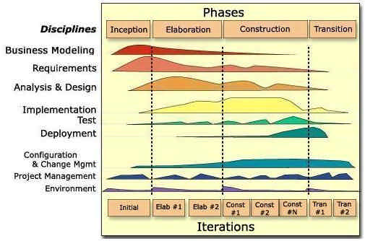
RUP phases, iterations and disciplines
Time
Diagram Copyright 1999-2005 IBM

Slide 26
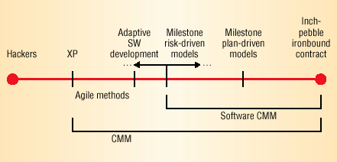
Spectrum of methods to meet different project needs
(Capability Maturity Model)
Source: "Get ready for agile methods, with care" by Barry Boehm, IEEE Computer, January 2002.

Slide 27
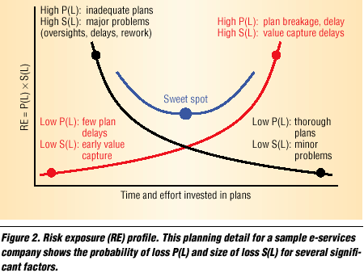
Boehm's risk exposure profile: How much planning is enough?
Need to get to market quickly
RE: Risk Exposure
P(L): Probability of Loss
S(L): Size of Loss
Black curve: Inadequate plans
Red curve:
Loss of market share
Source: "Get ready for agile methods, with care" by Barry Boehm, IEEE Computer, January 2002.

Slide 28
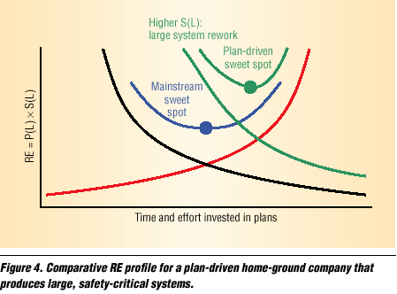
Safety-critical profile
RE: Risk Exposure
P(L): Probability of Loss
S(L): Size of Loss
Black curve: Inadequate plans
Red curve:
Loss of market share
Source: "Get ready for agile methods, with care" by Barry Boehm, IEEE Computer, January 2002.

Slide 29
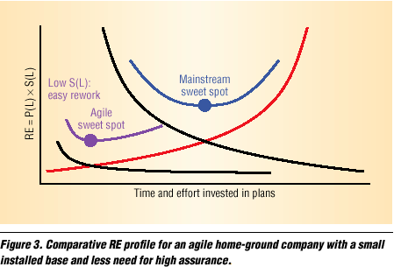
Agile profile
RE: Risk Exposure
P(L): Probability of Loss
S(L): Size of Loss
Black curve: Inadequate plans
Red curve:
Loss of market share
Source: "Get ready for agile methods, with care" by Barry Boehm, IEEE Computer, January 2002.

Slide 30
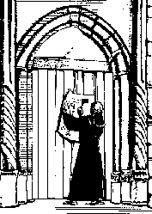
Agile Manifesto (2001)
We are uncovering better ways of developing software by doing it and helping others do it. Through this work we have come to value:
Individuals and interactions over processes and tools
Working software over comprehensive documentation
Customer collaboration over contract negotiation
Responding to change over following a plan
That is, while there is value in the items on the right, we value the items on the left more.
12 Principles behind the Agile Manifesto
http://agilemanifesto.org/

Slide 31
12 Principles of the Agile Manifesto
Our highest priority is to satisfy the customer through early and continuous delivery of valuable software.
Welcome changing requirements, even late in development. Agile processes harness change for the customer's competitive advantage.
Deliver working software frequently, from a couple of weeks to a couple of months, with a preference to the shorter timescale.
Business people and developers must work together daily throughout the project.
Build projects around motivated individuals. Give them the environment and support they need, and trust them to get the job done.
The most efficient and effective method of conveying information to and within a development team is face-to-face conversation.
http://agilemanifesto.org/principles.html

Slide 32
12 Principles of the Agile Manifesto
Working software is the primary measure of progress.
Agile processes promote sustainable development. The sponsors, developers, and users should be able to maintain a constant pace indefinitely.
Continuous attention to technical excellence and good design enhances agility.
Simplicity--the art of maximizing the amount of work not done--is essential.
The best architectures, requirements, and designs emerge from self-organizing teams.
At regular intervals, the team reflects on how to become more effective, then tunes and adjusts its behavior accordingly.
http://agilemanifesto.org/principles.html

Slide 33

Extreme Programming (XP)
Created by Kent Beck while working on a project for Chrysler in the late 1990s
Collaborators: Ward Cunningham and Ron Jeffries
One of the most well-known agile methods
Takes best practices to extreme levels
“Hard to get an XP t-shirt” - Rowland
http://www.extremeprogramming.org/

Slide 34
12 Extreme Programming Practices
The Planning Game
Small releases
Metaphor
Simple design
Testing
Refactoring
Pair programming
Collective ownership
Continuous integration
Sustainable pace
Whole team
Coding standards

Slide 35
The Planning Game
Business people decide:
scope
priority
release dates
Technical people decide:
estimates of effort
technical consequences
process
detailed scheduling
Requires a close collaboration between customers and developers not found in traditional plan driven approaches

Slide 36
Small releases
Every release should be as small as possible
Every release must completely implement its new features
Every release should contain the most valuable business features
Contrast with RUP where you focus on the biggest risk first

Slide 37
Metaphor
Metaphor is a simple explanation of the project
Agreed upon by all members of the team
Simple enough for customers to understand
Detailed enough to drive the architecture
Metaphor replaces architecture as 10,000 feet view of the system

Slide 38
Simple design
Successfully runs all the tests
Has no duplicated logic
States every intention important to programmers
Has the fewest possible classes and methods

Slide 39
Testing
Any feature without an automated test does not exist
Programmers need confidence in correct operation
Customers need confidence in correct operation

Slide 40
Refactoring
Rewrite or restructure the code to improve the implementation
Always ask if there is a way to make the program simpler
When the system requires duplication of code, it is asking for refactoring
Can always find a series of small, low-risk steps

Slide 41
Pair programming
All code written with two people at one machine
Driver:
thinks about best way to implement
Navigator:
thinks about viability of whole approach
thinks of new tests
thinks of simpler ways
Switch roles frequently

Slide 42
Collective ownership
Anybody who sees an opportunity to add value to any portion of the code is required to do so
Everyone knows something about everything
Everyone feels obligated to make improvements

Slide 43
Continuous integration
Integrate and test every few hours, at least once per day
Don’t wait until the very end to begin integration
All tests must pass
Easy to tell who broke the code
Problem is likely to be in code that was most recently changed

Slide 44
Sustainable pace (40-hour week)
People should be fresh and eager every morning
Overtime is a symptom of a serious problem
XP only allows one week of overtime

Slide 45
Whole Team (On-site customer)
Customer is a member of the team
Real customer will use the finished system
Programmers need to ask questions of a real customer
Clarify requirements or explain what’s needed
Customer sits with the team
Customer can get some other work done while sitting with programmers

Slide 46
Coding standards
Everyone edits everyone's code
Standard should require least amount of overhead
Standard should be adopted voluntarily by the team

Slide 47
Workspace
http://study.com/cimages/multimages/16/openworkspace.png

Slide 48

Questions?

